Slide 1
Rotary District 7360 Youth Exchange Program
Notes:
Welcome Everyone to the Zoom Presentation of Rotary Youth Exchange District 7360
Will be using two terms
Rotary Youth Exchange – program within Rotary in which high school students travel to and live in another country to learn the customs and daily life of the citizens of that country. There are districts and clubs within Rotary who support and sponsor each exchange student
Essex stands for Eastern States Student Exchange and is the name of the region of which this district belongs. It spans from Quebec Canada down through the eastern section of the US and into Bermuda. Essex is the “parent organization” who establishes most of the rules involving Youth Exchange in our district

Slide 2
What is Rotary “Service Above Self”
Founded in in Chicago 1905 by Paul Harris
“Rotated” Meetings
In six continents within 16 years
Rotary is a global network of 1.2 million
Record over 16 million volunteer hours yearly
Fight disease
Provide clean water, sanitation, and hygiene
Save mothers and children
Support education
Grow local economies
Promote peace
Notes:
An International Service organization whose motto is “Service above Self”
Joined with three other businessmen to see what they could “form friendships and exchange meaningful ideas”
Name “Rotary” was established because they “rotated” their meetings between the offices of the four members
Concept grew and within 16 years there were clubs in 16 continents
Now a network of 1.2 million volunteers across the world
On the right are some of the areas Rotary supports with their efforts;
Fight disease – in 1979 took on the challenge to eradicate Polio – since then over 2.5 billion people have been immunized and it only exists in 2 countries Pakistan and Afghanistan less than 125 cases worldwide
Community initiatives include next four bullets including such things as new water systems, teaching and supporting mothers who need basic family skills, building schools and providing educational materials and helping to create small businesses
Promote peace – Claim to fame -Rotary the only charitable organization who has a permanent seat at the United Nations giving us a voice in world peace. Sponsor numerous peace initiatives across the world
This is where Rotary Youth Exchange fits into the picture

Slide 3
“My dream is for every 17-year-old to become a Youth Exchange student. If we could achieve this, there would be no more wars.”
Carl-Wilhelm Stenhammer, President Rotary International, 2005-2006
Notes:
A few years old, but a good quote from a form RI president that holds true today.
By getting young adults together during high school there can be more understanding and acceptance across the world

Slide 4
Two Types of Exchange Opportunities
Long Term
10 Months Long
Academic Year
1-3 Host Families
Travel Arrangements made by Tzell Travel Agency
Includes an Application and Registration Fee
Short Term
3-6 Weeks
School Breaks (Summer)
Direct Exchange w/Families
Travel Arranged by Family
$350 Registration Fee, Family is Responsible for remaining costs
Notes:
Here primarily to discuss the Long Term Program, remiss if Short Term isn’t mentioned for those who aren’t quite ready for the Long Term
Differences listed, but also have some similarities too

Slide 5
Criteria for all Exchange Students
Sponsorship by a local Rotary Club
Able to represent USA as an Ambassador
Abide by the deadlines and instructions pertaining to the exchange
The ability to communicate
15 to 18.5 at time of departure
Agree to the Four D’s
Notes:
Must receive paperwork from the club indicating they are sponsoring you
Representing the US – may be the only US citizen they see – make sure behavior is how you want the people of the country to think of Americans
Third bullet - pretty simple – many people involved in making the experience happen. Need to get applications and forms in on time
Fourth communicate with and in front of people – (that will come with time) – ask if you have questions, call if you run into any problesms –Let us know what is going on!!
Age Depending on where you go, those age limits can change. Make sure the country you want fits your age and language requirements
Four D Rules Drinking, Drug, Driving and Dating. Dating meaning, no falling in love!

Slide 6
A Typical Rotary Youth Exchange Student
Solid Academic Background
Foreign Language Background
Active in Extra Curricular Activities
Good Character
Adaptable and Flexible
Notes:
Academics going to school in a different country, with a different language. It will be challenging until you get used to the language
Familiarity with the language is always helpful. Some countries it is a requirement! Don’t rule out a country if you don’t know the language
Extra Curricular activities we are looking for well rounded students who can work with or lead aa team.
Good Character – as we sent earlier – you are an ambassador – we want you to make us proud. Your behaviour will reflect on yourself, Rotary and your country
This will be different – if you are unable to adapt or be flexible, your stay will be next to impossible

Slide 7
The Year Abroad (The Long -Term Exchange)
High School Experience
Hosted by Families
Sponsored by a Hosting Club
Rotary Counselor
Notes:
Long Term Exchange is an Educational exchange. Must attend school.
You will be staying with families selected by the hosting country. All families will be vetted before a student can live with them
Just like a club will sponsor you to go, a club in the new country will be hosting you. The expectation is that you will participate in meetings and events sponsored by the clubs. This will usually include presentations to the club, district schools, etc.
You will have a counsellor – someone who will act as your advocate should you have issues with your host family, school or friends. Receive a Stipend, determined by hosting club

Slide 8
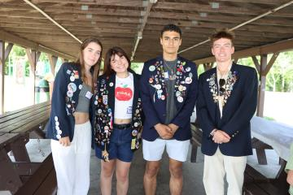
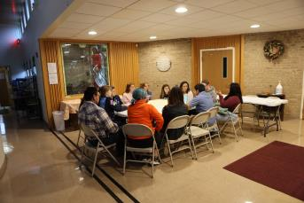
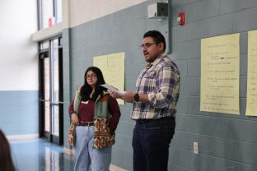
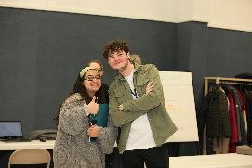
Rotex (Rebounds)
Notes:
Rotarians and spouses are easy to understand, but let me tell you about the ed Rotex. Students who have been abroad on exchange and then come back to help with future exchange students.
Like to consider Youth Exchange as a three year commitment – a year of preparation, a year abroad and then a year “giving back”. Most love the opportunity!
Valuable to our program because they have lived what you are about to experience and can answer questions for you.

Slide 9
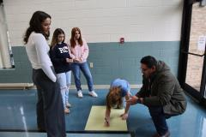
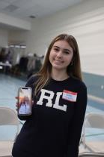
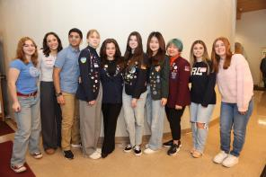
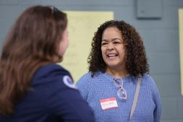
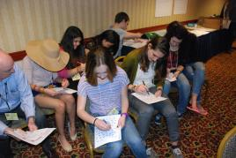
Outbound Orientation
Notes:
In March, you will have a weekend long orientation on preparing for your exchange year. Everyone arrives Saturday morning, students and parents. Saturday is a day of answering final questions from everyone.. An opportunity to hear more about the country to which you are going. Parents leave Saturday afternoon. Students have more training through some games and classes. Intro speeches are given, cultural lessons explored and challenges for you all! A busy weekend, but fun.
Final get together is the District Conference. One last time to get together before you head off for the summer and your adventure beginning in a few months. This year the end of April.
No pictures as last years was cancelled due to the Covid Pandemic. We arrive on Friday and practice for what many say is the highlight of the conference – the Youth Exchange Lunch. All of the exchange students participate in a “talent/appreciation” lunch program. So think about your talents if you are selected for the program! Once the lunch is over, it is free time and something fun to finish out the weekend.

Slide 10
Financial Considerations
Round Trip Airfare
Passport, Visa, and Related Expenses
Initial Registration Fee ($50.00)
Application Fee ($2250) which covers the following:
Medical Insurance
Orientation Expenses
Essex Fees
Travel Agency Fee
Pins
Notes:
Important topic for everyone.
Proud to say we are one of the least expensive exchange programs out there. Purpose is to create experiences for high school students, not make money.
All funds we collect go back into the program.
See what the up front costs are –first two bullets – cost depends on which country you choose.
Registration Fee – pays for getting you registered and into the Essex Data Base and allows us to have your contact information online and track your progress through the process. This is non refundable
District Fees covers what you see here.

Slide 11
More Financial Information
Personal Items
Hosting District Insurance?
Language Camp?
Host Club Allowance
Scholarships
Assistance for travel and fees
Notes:
Need to plan on supporting the student with items the host families will not provide
Host families- food, lodging, family entertainment/events
different countries or even families will cover different things
Student responsible for clothing, gifts, in some cases personal care items
Next two – again depending on the country
ou may be required to buy local insurance (if so, you will get some money back for our insurance)
Depending on your knowledge level of the language, a few countries require a camp upon arrival
Essex and the District do offer partial scholarships for help with travel and

Slide 12
Important Dates for Outbound Students
November Deadline to Submit Part 1 of Application
Early December District Interviews
Late December Deadline to Submit Part 2 of Application
February, 2025 Winter Picnic
March, 2025 OB Orientation
August, 2025 Leave for Exchange
July, 2025 “Rebound” Picnic”
Notes:
Start the process by mid to late October
find sponsor club / interviewed by club
name is submitted to the district as a possible candidate
Nov/Dec begin the application once these steps are done.
you will submit a registration fee
begin the online part of the application
District will register Part 1 of the application upon completion of the app and receipt of the fee
December 12 should have completed the additional steps of the application for interview process by district
Feb 1 application must be completed to get country assignment
March 20-21 Outbound Orientation. Time for parents and students to get more questions answered by the volunteers
April 30-May 1 District Rotary Conference learn more about Rotary and meet district leaders
August – Leave for Exchange
July 2022 Rebound Picnic where everyone gets to meet up and share your experiences. Also time for you to offer suggestions and improvements.

Slide 13
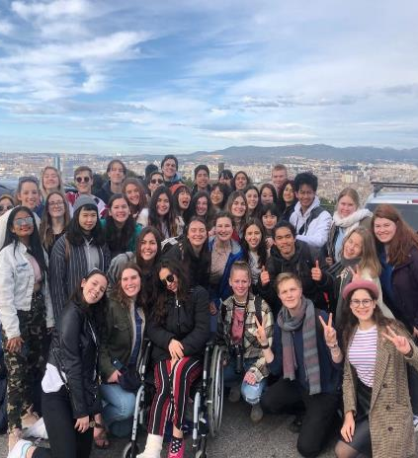
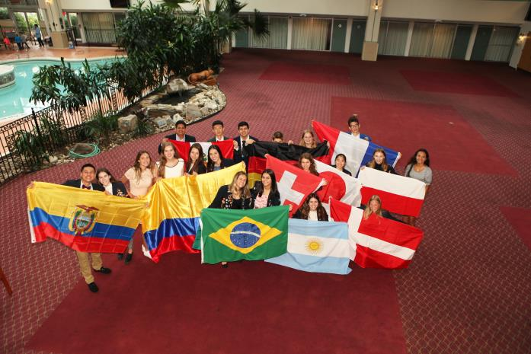
we are the world
France
USA
Notes:
As an exchange student in another country, you will meet other exchange students from all over the world. Irianna shared her picture of her friends in France last year and this picture was from this last year during our Outbound Orientation. You meet and make lifelong friends from all over the world!
As an exchange student in another country, you will meet other exchange students from all over the world. Irianna shared her picture of her friends in France last year and this picture was from this last year during our Outbound Orientation. You meet and make lifelong friends from all over the

Slide 14
For More Information, Including the Application:
www.exchangestudent.org
Isaac Fisher sach17866@yahoo.com
Mary Jane Smith mj1em1s@aol.com

